Slide 1
CONGENITAL ANOMALIES OF THE RESPIRATORY TRACTT
ASHIONO E. M

Slide 2
CHOANAL ATRESISA

Slide 3
Choanal atresia:
Obliteration of the posterior nasal aperture by a bony or membranous septum
Often associated with bony abnormalities of the pterygoid plates and midfacial growth abnormalities.
Most common congenital anomaly of the nose
Prenatal use of antithyroid (methimazole, carbimazole) medications was linked to choanal atresia.

Slide 4
Complete nasal obstruction in a newborn may cause death from asphyxia.
  During inspiration, the tongue is pulled to the palate, and obstruction of the oral airway results.
  Vigorous respiratory efforts produce marked chest retraction.
  Increased cyanosis and death may occur;
    however, if the infant cries and takes a breath through the mouth, the airway obstruction is momentarily relieved.
    Then the crying stops, the mouth closes, and the cycle of obstruction is repeated.

Slide 5
Epidemiology:
  Occurs in 0.82 cases/10,000.
  Unilateral atresia commonly occurs on the right side.
  unilateral > bilateral; 2:1.
  A slightly increased risk exists in twins.
  Chromosomal anomalies are found in 6%.
  5% have monogenic syndromes or conditions.
  Females > males.

Slide 6
Clinical:
Symptoms of severe airway obstruction and cyclical cyanosis are the classic signs
  Crying alleviates respiratory distress.
  Unilateral atresia may present with unilateral rhinorrhea or congestion.
Associated with:
  narrowed nasopharynx
  widened vomer
  medialized lateral nasal wall
  arched hard palate.

Slide 7
Associated malformations occur in 47% of infants without chromosome anomalies.
Associated with CHARGE syndrome:
  Coloboma of the iris, choroid, and/or microphthalmia
  Heart defect; ASD, conotruncal lesion
  Atresia of choanae
  Retarded growth and development
  Genitourinary abnormalities e.g. cryptorchidism, microphallus, and/or hydronephrosis
  Ear defects with associated deafness

Slide 8
Diagnostic procedures:
Failure to pass an 8F catheter through the nasal cavity more than 5.5 cm from the alar rim.
The lack of movement of a thin wisp of cotton under the nostrils while the mouth is closed
The absence of fog on a mirror when it is placed under the nostrils
Gently blowing air into each nasal cavity with a Politzer bag
A flexible fiberoptic endoscope to assess the deformity.
Automatic tympanometry
  sensitivity and specificity of the technique in diagnosing a patent nostril is 100%.

Slide 9
Imaging:
CT scanning:
  Radiographic procedure of choice.
  For good results, suction to clear excess mucus, and a topical decongestant is applied.
    Confirm the diagnosis of choanal atresia (unilateral or bilateral).
    Evaluate choanal atresia (vomer bone width and choanal airspace distance).
    Exclude other possible nasal sites of obstruction.
    Determine the degree of bony, membranous, or mixed atresia.
    Delineate abnormalities in the nasal cavity and nasopharynx.

Slide 10
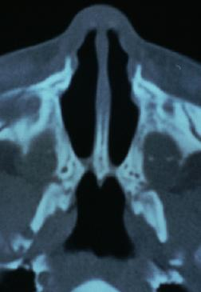
CT scan with intranasal contrast:
  narrowing of the posterior nasal cavity at the level of the pterygoid plate.

Slide 11
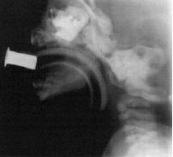
Imaging:
Rhinography:
  administration of radiopaque dye into the nasal cavity.
Rhinogram demonstrating blockage of radiopaque dye at the posterior choanae.

Slide 12
Treatment:
Emergency:
  Insert an oral airway to break the seal formed by the tongue against the palate.
    Can be well tolerated for several weeks.
  McGovern nipple, and intubation are viable options.

Slide 13
Elective definitive Rx:
  Restore the normal nasal passage
  Prevent damage to growing structures important in facial development
  Technically safe
  Requires short operative time, and provides short hospitalization and convalescence.

Slide 14
Surgery:
Transnasal puncture
The transseptal technique
Transpalatal repair
The nasal or retropalatal endoscopic repair
Carbon dioxide and potassium titanyl phosphate (KTP) lasers
Follow-up:
  patients may require operative debridement or periodic dilatations.

Slide 15
LARYNGOMALACIA

Slide 16
Laryngomalacia is the most common cause of chronic inspiratory noise in infants.
They have a higher incidence of GERD, presumably a result of the more negative intrathoracic pressures necessary to overcome the inspiratory obstruction.
When the epiglottis is involved, gravity makes the noise more prominent when the baby is supine.

Slide 17
Clinical:
History:
  Inspiratory noises typically start at age 4-6 weeks, but they may begin as late as age 2-3 months.
  May sound like nasal congestion, but the noises persist and no nasal secretions are present.
  The noise may be more high pitched; crowing stridor.
  Worsened by supine position, crying or agitation, during URTI, and during and after feeding.
  The baby's cry is usually normal.
  No feeding intolerance is noted, although choking or coughing with feedings may be noted if there is reflux.
  The infant is usually happy and thriving.

Slide 18
Physical exam:
  The baby is usually happy and appropriately interactive.
  Mild tachypnea, but oxygen saturation is normal.
  Nasal airflow is detectable.
  The cry is normal.
  The noise is purely inspiratory, best heard just above the sternal notch.
  The other exam is essentially normal.

Slide 19
Fluoroscopy
  The cartilages may be observed collapsing on inspiration on a lateral view of the airway.
Laryngoscopy and bronchoscopy
  To confirm the diagnosis.
  An omega-shaped epiglottis that prolapses over the larynx during inspiration.
  Enlarged arytenoid cartilages that prolapse over the larynx during inspiration may also be present.
Notes:
Dr Ogaro-bronchoscopy under nothing is preferable b4 u paralyse the muscles

Slide 20
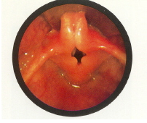
The epiglottis is small and curled on itself (omega-shaped). Approximation of the posterior edges of the epiglottis contributes to the inspiratory obstruction.

Slide 21
Treatment:
In >99%, the only treatment necessary is time.
  The noise steadily increases over the first 6 months, as inspiratory airflow increases with age.
  A plateau then occurs with a subsequent gradual disappearance of the noise by age 2 years in virtually all infants.
  In some cases, the signs and symptoms dissipate, but the pathology may persist into childhood and adulthood and symptoms or signs may recur with exercise or with viral infections.
May sleep prone, although if symptoms are not severe supine sleep is recommended.

Slide 22
Supplemental oxygen for significant hypoxemia (a resting SPO2 <90%).
  Monitor for pulmonary hypertension.
Surgery:
  Indicated:
    impair normal eating, growth, and development
  Operations:
    Simple tracheotomy or laryngoplasty in which support structures are tightened and excess tissue on the epiglottis is removed.
    Laser epiglottopexy

Slide 23
Tracheomalacia
Definition; is a weakness and floppiness of the walls of the trachea.
Occurs when the cartilage does not develop properly; Instead of being rigid, the walls of the trachea are floppy.
Congenital tracheomalacia is very uncommon.
Chronic monophonic wheeze with or without a barking cough.
Respiratory symptoms do not respond to bronchodilators.

Slide 24
Tracheomalacia
Treatment
Most infants respond well to humidified air, careful feedings, and antibiotics for infections. Babies with tracheomalacia must be closely monitored when they have respiratory infections.
Often, the symptoms of tracheomalacia improve as the infant grows.
Rarely, surgery is needed.

Slide 25
TRACHEOESOPHAGEAL FISTULA(TEF) AND ESOPHAGEAL ATRESIA(EA)

Slide 26
Presentation:
Frothing and bubbling at the mouth and nose after birth
Episodes of coughing, cyanosis, and respiratory distress
Feeding exacerbates symptoms, causes regurgitation, and may precipitate aspiration.

Slide 27
DIAGNOSIS
Antenatal:
  maternal polyhydramnios
  a small stomach
  a distended upper esophageal pouch
  abnormal swallowing
  look out for associated abnormalities

Slide 28
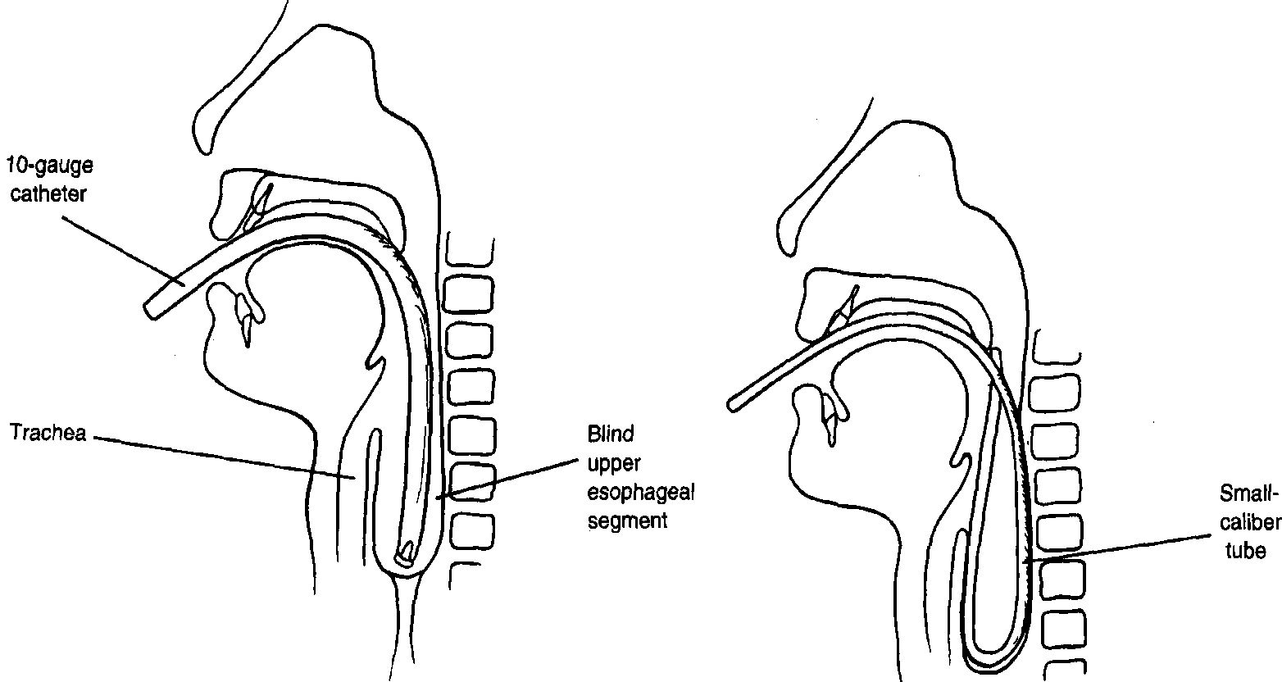
Clinical Diagnosis
Diagnosis of EA is confirmed when a 10-gauge (French) catheter cannot be passed beyond 10 cm from the gums.
A smaller-caliber tube is not used because it may curl up in the upper esophageal segment, giving a false impression of esophageal continuity.

Slide 29
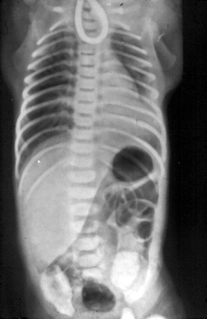
The chest radiograph
A plain radiograph will confirm the tube has not reached the stomach

Slide 30
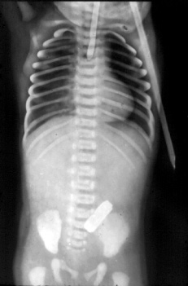
The Gasless Abdomen
Absence of gas in the abdomen suggests that the patient has either atresia without a fistula or atresia with a proximal fistula only

Slide 31
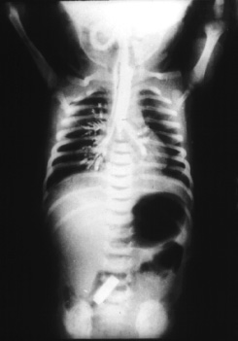
Contrast studies
Ultravist swallow:
  A small amount (0.5 to 1 mL) of water-soluble contrast is used.
  Care must be taken to avoid aspiration.

Slide 32
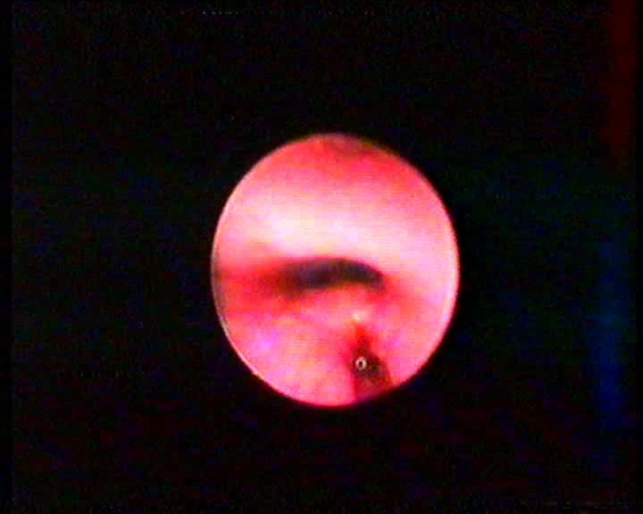
Bronchoscopy
  Level of fistula
  Exclude upper pouch fistula
  Identify laryngoesophageal cleft

Slide 33
Management:
Maintain a patent airway and prevent aspiration:
  Minimal handling
  Prone positioning
  NPO, IVF, TPN as needed
  Avoid bag-mask ventilation, ETT and mechanical ventilation
  Maintain in partial upright position at 45°
  Repeated upper esophageal pouch suctioning q10min or low continuous suctioning

Slide 34
Definitive Rx:
  Surgical ligation of the TEF and primary end-to-end anastomosis of the esophagus are performed when feasible.
  In the premature or complicated infant, a primary closure may be delayed by temporizing with fistula ligation and gastrostomy tube placement.
  If the gap between the atretic ends of the esophagus is >3–4 cm, primary repair cannot be done;
    options include using gastric, jejunal, or colonic segments interposed as a neo-esophagus.

Slide 35
Complications:
Anastomotic leak
Re-fistulization
Anastomotic stricture.
Gastroesophageal reflux disease (GERD)
  intrinsic abnormalities of esophageal function
  delayed gastric emptying

Slide 36
Prognosis:
Category A patients:
  >2.5 kg at birth and who are otherwise well
  98% survival
  Immediate primary repair
Category B patients:
  1.8-2.5kg and are well or have higher Bwt and moderate pneumonia and other congenital anomaly;
  82% survival
  Delayed repair
Category C patients:
  < 1.8 kg or have higher Bwt and severe pneumonia and severe congenital anomaly.
  50% survival
  Staged repair
Waterston, DJ. et al. Congenital tracheo-oesophageal fistula in association with oesophageal atresia. Lancet. 1963 Jul 13;2:55-7.
Lopes PJ, Keys C, Pierro A, et al. Oesophageal atresia: improvedoutcome in high risk groups? J Pediatr Surg 2006;41:331- 4.

Slide 37
THE LUNG
Pulmonary agenesis and hypoplasia
Pulmonary sequestration
Congenital lobar emphysema
Congenital cystic adenomatoid malformations

Slide 38
Pulmonary hypoplasia
Pathology:
  reduced lung weight, alveolar number, fewer generations of airways, and hypoplasia of the corresponding pulmonary arteries.
  epithelial differentiation is delayed, and surfactant deficiency is associated.

Slide 39
Clinical:
History:
  Variable onset depending on the extent of hypoplasia and other anomalies.
  Poor fetal movement or amniotic fluid leakage and oligohydramnios may exist.
  May be asymptomatic
  Present with severe respiratory distress or apnea requiring extensive ventilatory support.
  In older children, dyspnea and cyanosis on exertion or a h/o repeated respiratory infections.

Slide 40
Physical exam:
  Small, bell shaped thorax with or without scoliosis.
  A mediastinal shift towards the involved side
  Decreased or absent breath sounds on the side of hypoplasia, especially over the bases and axilla.
  Pneumothorax, spontaneous or associated with mechanical ventilation.
  Compression deformities from prolonged oligohydramnios, contractures, Potter facies (ie, hypertelorism, epicanthus, retrognathia, depressed nasal bridge, low set ears), and arthrogryposis.

Slide 41
    In pts with a neuromuscular disease;
      myopathic facies with a V shaped mouth, muscle weakness, and growth retardation.
    Abdominal masses, e.g. cystic renal diseases and enlarged bladder.
    Associated anomalies; CVS, GI and GUT, as well as skeletal anomalies of the vertebrae, thoracic cage, and upper limbs.

Slide 42
Lab;
If the cause is renal pathology:
  serum creatinine
  blood urea, and electrolytes

Slide 43
Imaging:
Fetal ultrasonography:
  renal malformations
  oligohydramnios
  decreased fetal movts in fetal neuromuscular diseases.
  3D fetal ultrasonography can be used for direct volume estimation of the fetal lung and definitive diagnosis of pulmonary hypoplasia.

Slide 44
CXR;
  mediastinal shift in severe cases with a homogenous density on the involved agenetic side
  compensatory herniation of the contralateral lung across the mediastinum
  bell-shaped chest, and rib deformities
  diaphragmatic hernia
  associated skeletal anomalies, scimitar syndrome, and sequestration may be identified.

Slide 45
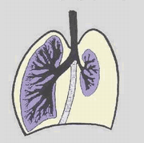
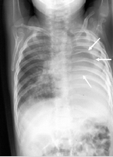
AP CXR of a 7-month-old infant shows opacity of the left hemithorax and small left lung (arrows).
Schematic illustrating pulmonary hypoplasia.

Slide 46
Chest CT scanning:
  loss of lung volume and abnormal or absent normal airway branching to the affected lung.
Echocardiography:
  to identify associated cardiac anomalies.
MRI or magnetic resonance angiography (MRA):
  to identify the smaller pulmonary arterial supply to the affected lung
  the presence of other abnormal vascular anatomy

Slide 47
Treatment:
Respiratory support:
  Ranging from oxygen to mechanical ventilation.
  Permissive hypercapnia has been used, especially in cases of congenital diaphragmatic hernia.
  Partial liquid ventilation has also been tried, without definite advantages.
  ECMO is indicated in infants with diaphragmatic hernia associated with pulmonary hypoplasia and when mild hypoplasia is complicated by persistent PHT.
    (Extracorporeal Membrane Oxygenation -ECMO)

Slide 48
Surfactant at 4 mL/kg at birth in pulmonary hypoplasia secondary to congenital diaphragmatic hernia:
  Efficacious in improving oxygenation
  decreasing the need for ECMO
  improve the survival rate.
    lung tissue stores of surfactant protein B and phosphatidylcholine were low in diaphragmatic hernia.
Surgery for correctable anomalies

Slide 49
PLUG (plug the lung until it grows) procedure:
  Fetoscopic tracheal occlusion with a clip improves lung growth and prevents pulmonary hypoplasia. The clip is removed bronchoscopically during delivery, when the fetus is partly exteriorized while on umbilical circulatory support. The airway is secured and then the fetus is delivered.

Slide 50
        CONGENITAL CYSTIC ADENOMATOID MALFORMATION(CCAM)

Slide 51
Clinical:
  In the newborn period or early infancy:
    respiratory distress, recurrent respiratory infection, and pneumothorax.
    may be confused with a diaphragmatic hernia.
  Patients with smaller lesions are asymptomatic until mid-childhood
    brief episodes of recurrent or persistent pulmonary infection or relatively acute chest pain occur.
    breath sounds may be diminished, with mediastinal shift away from the lesion.

Slide 52
….
Recurrent infections occur because the mucociliary clearance is poor. The affected area is dull on percussion, and air entry is decreased.
Pressure on the heart and large vessels results in hydrops fetalis, & polyhydramnios if pressure is on the esophagus
Malignancy can occur in the CAM (pulmonary blastoma, rhabdomyosarcoma, and bronchoalveolar carcinoma).

Slide 53
Diagnosis:
Intrauterine ultrasonography:
  signs of fetal distress including hydrops
  pleural effusion
  polyhydramnios, ascites and severe facial edema.
  Large lesions, may produce pulmonary hypoplasia in nonaffected lobes.
  Lesions may regress and be associated with good pulmonary function in childhood.
Postnatal diagnosis is made with plain chest radiography
CT allows for accurate sizing of the lesion and differentiating it from congenital lobar emphysema and bronchogenic cysts.

Slide 54
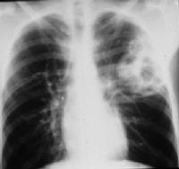
CAM
    Chest radiograph:
      a cystic mass, sometimes with mediastinal shift.
      Occasionally, an air-fluid level suggests a lung abscess.

Slide 55
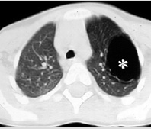
  CT scan of a 5-year-old child shows a hypoattenuating, clearly delineated cystic mass (*) in the left upper lobe.

Slide 56
THORACIC Anomalies
Congenital Diaphragmatic Hernia

Slide 57
Prenatal Diagnosis
Fetal Ultrasonography (as early as the second trimester)
Mediastinal shunt
Viscera herniation (stomach, intestines, liver*, kidneys, spleen and gall bladder)
Abnormal position of certain viscera inside the abdomen
Stomach visualization out of its usual position
Intrauterine growth retardation*
Polyhydramnios*
Fetal hydrops*
* bad prognosis

Slide 58
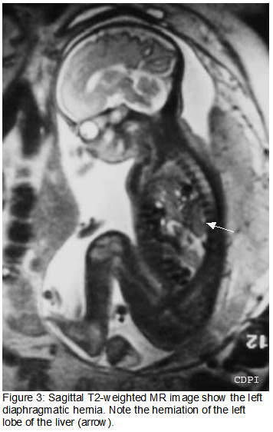
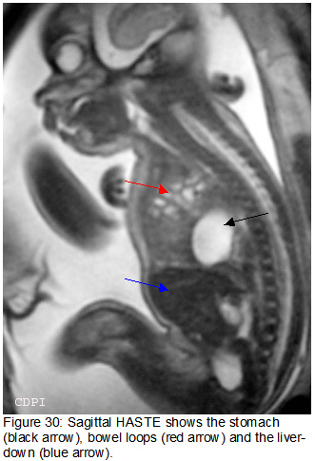
Prenatal MR Imaging of CDH

Slide 59
Postnanal presentation
Respiratory distress
  Dyspnea
  Cyanosis
  Apparent dextrocardia
Scaphoid abdomen with barrel chest
Auscultation of the lungs reveals poor air entry, bowel sounds in the chest
Shift of the heart to the side opposite

Slide 60
Delivery Room Management
Deliver in a center that has experienced personnel and available therapies.
Personnel should be experienced in the immediate resuscitation and stabilization of critically ill neonates
Affected patients in any respiratory distress require positive pressure ventilation in the delivery room.
To prevent distension of the GIT and further compression of the pulmonary parenchyma, a double-lumen nasogastric or orogastric tube of large caliber is placed to act as a vent.
Early intubation is preferable to bag-mask ventilation or continuous positive airway pressure via mask or nasal prongs

Slide 61
Intubation and mechanical ventilation
  Endotracheal intubation and mechanical ventilation are required for all infants with severe CDH who present in the first hours of life.
  Avoid bag-and-mask ventilation in the delivery room because the stomach and intestines become distended with air and further compromise pulmonary function.
  Avoid high peak inspiratory pressures and overdistension. Consider high-frequency ventilation if high peak inspiratory pressures are required.

Slide 62
Lab Studies
Arterial blood gas
  To assess for pH, PaCO2, and PaO2.
  Persistent pulmonary hypertension (PPHN) with right-to-left ductal shunting often complicates CDH. The PaO2 may be higher from a preductal (right-hand) sampling site.
Chromosome studies
  Frequent association with chromosomal anomalies.
  In rare cases, chromosomal disorders that can only be diagnosed by skin biopsy may be present.
Serum electrolytes
  Monitor serum electrolytes, ionized calcium, and glucose levels initially and frequently.

Slide 63
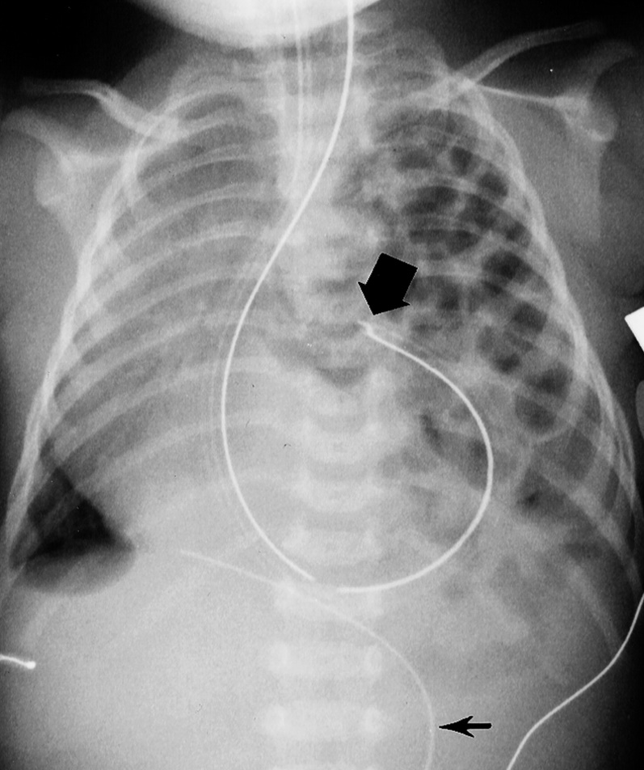
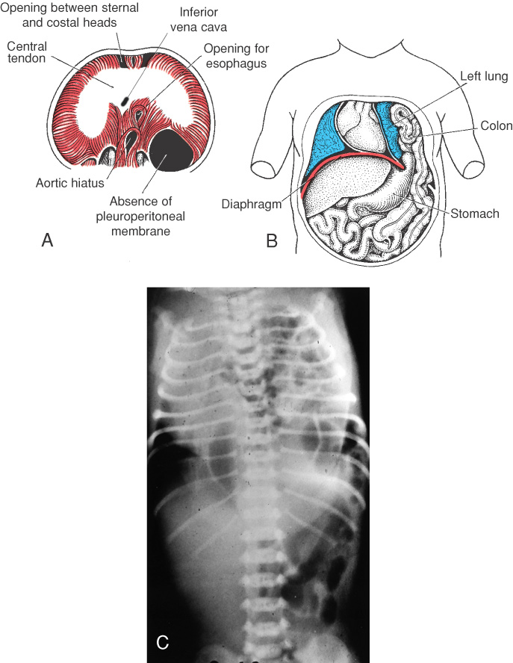

Postnanal Diagnosis of left sided CDH
Radiograph in a male neonate shows the tip (large arrow) of the nasogastric tube positioned in the left hemithorax. Note the marked apex leftward angulation of the umbilical venous catheter (small arrow).

Slide 64
Imaging Studies
Cardiac ultrasonography
  To rule out congenital heart diseases because the incidence of associated cardiac anomalies is high (up to 25%).
Renal ultrasonography:
  To rule out genitourinary anomalies.
Cranial ultrasonography
  Perform cranial sonography if the infant is being considered for extracorporeal support.
  Focus on evaluation of IVH and peripheral areas of hemorrhage or infarct or intracranial anomalies.

Slide 65
Other Tests
Pulse oximetry
  Continuous pulse oximetry is valuable in the diagnosis and management of PPHN.
  Place oximeter probes at preductal (right-hand) and postductal (either foot) sites to assess for a right-to-left shunt at the level of the ductus arteriosus

Slide 66
Postnatal management
Mechanical ventilation
Surgery
Nitric Oxide
  endothelium - derived relaxing factor (EDRF) with selective pulmonary vasodilation
  rapidly metabolized but has not been shown to improve survival
Surfactant

Slide 67
Surgery:
Indications for surgery:
  Reversal of ductal shunting
  O₂ index of < 40
  Arterial pCO₂ maintainable under 40 mmHg
  Hemodynamic stability

Slide 68
Prognosis
Pulmonary recovery:
  When all resources, including ECMO, are provided, survival rates range from 40-69%.
Long-term morbidity:
  Chronic lung disease
  Growth failure
  Gastroesophageal reflux
  Neurodevelopmental delay.

Slide 69
Ref:
Upto date 17.3
Nelson’s textbook of pediatrics 18th edition
e-medicine
Moya et al. Evidence Based Management of Infants with Congenital Diaphragmatic Hernia. Semin Perinatol 2005; 29: 112-7

Slide 70
